Slide 1
TDD Hands On 3
Xiao Wei

Slide 2
ATDD
Story: Returns go to stock
In order to keep track of stock As a store owner I want to add items back to stock when they're returned
Scenario 1: Refunded items should be returned to stock
Given a customer previously bought a black sweater from me
And I currently have three black sweaters left in stock
When he returns the sweater for a refund
Then I should have four black sweaters in stock
Scenario 2: Replaced items should be returned to stock
Given that a customer buys a blue garment
And I have two blue garments in stock
And three black garments in stock.
When he returns the garment for a replacement in black,
Then I should have three blue garments in stock
And two black garments in stock

Slide 3
Exercise: Game Of Life
This Kata is about calculating the next generation of Conway's game of life, given any starting position. See http://en.wikipedia.org/wiki/Conway%27s_Game_of_Life for background.
You start with a configure file defining a two dimensional grid of cells defined, where each cell is either alive or dead. The grid is finite, and no life can exist off the edges. When calcuating the next generation of the grid, follow these rules:
1. Any live cell with fewer than two live neighbors dies, as if caused by under population. （如果有少于两个(不包含)邻居的活细胞在下一代会死去）
2. Any live cell with more than three live neighbors dies, as if by overcrowding.
（如果有多于三个(不包含)邻居的活细胞在下一代会死去）
3. Any live cell with two or three live neighbors lives on to the next generation.
（如果有两个或三个邻居的活细胞在下一代还活着）
4. Any dead cell with exactly three live neighbors becomes a live cell.
（如果刚好有三个邻居的死细胞在下一代会复活）
You should write a program that can accept one configure file, and will output a similar grid showing the next generation in every 1 second.

Slide 4

Game Of Life : Sample
....
.**.
.**.
....
.....
.....
.***.
.....
.....

Slide 5
Game Of Life : Configure
Configure File Sample 3
<configure>
<dimension width= 4 height= 4 />
<alive_cells>
<alive_cell x=1 y=1/>
<alive_cell x=1 y=2/>
<alive_cell x=2 y=1/>
<alive_cell x=2 y=2/>
</alive_cells>
</configure>
Configure File Sample 1
dimension: 4,4
alive_Cells: 1,1; 1,2; 2,1; 2,2
Configure File Sample 2
{
"dimension": { "width": 4, "height": 4 },
"alive_cells": [ [1,1], [1,2], [2,1], [2,2] ]
}

Slide 6
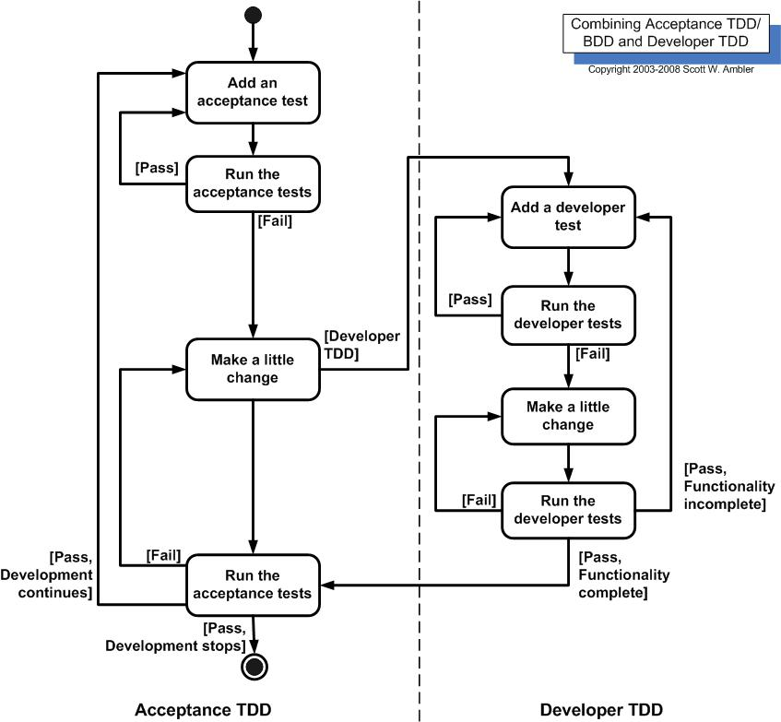
Requirement →
Big Story →
Small Stories →
Scenarios →
Acceptance Criteria →
Class Design
Activity & Sequence
Design (New class/method)

Slide 7
Stories
Story 1: 玩家可以指定生命世界的大小，运行游戏后，游戏可以按照指定的大小显示出生命世界。
Story 2: 玩家可以指定生命世界的大小和初始活细胞，运行游戏后，游戏可以按照指定的大小显示出生命世界，包括初始活细胞。
Story 3: 玩家可以指定生命世界的大小和位于中心位置（可以有8个邻居）的细胞，运行游戏后，游戏可以按照指定的大小显示出生命世界，包括初始活细胞，同时可以产生下一代的生命结果。
Story 4: 玩家可以指定生命世界的大小和位于边界位置（只能有5个邻居）的细胞，运行游戏后，游戏可以按照指定的大小显示出生命世界，包括初始活细胞，同时可以产生下一代的生命结果。
Story 5: 玩家可以指定生命世界的大小和位于角落位置（只能有3个邻居）的细胞，运行游戏后，游戏可以按照指定的大小显示出生命世界，包括初始活细胞，同时可以产生下一代的生命结果。
Story 6: 玩家可以指定生命世界的大小和初始活细胞，运行游戏后，游戏可以按照指定的大小显示出生命世界，包括初始活细胞，同时可以每隔一秒产生下一代的生命结果。

